Slide 1

Predicting Student Enrollment Using Markov Chain Modeling in SAS
Samantha Bradley, M.A. Applied Economics
Office of Institutional Research
University of North Carolina at Greensboro

Slide 2
Office of Institutional Research
The University of North Carolina at Greensboro
Public, coeducational state university founded in 1891
​18,846 students enrolled in Spring 2018
IR aggregates, analyzes, and disseminates data in support of:
  Institutional planning
  Policy formulation
  Decision-making for internal/external constituents

Slide 3
Why Enrollment Projections?
IR prepares Enrollment Projections every year
  Headcounts by student level
  Student credit hours by cost category
Used by UNC System Office during decision-making about university funding
Helps the university plan resource allocation
Identify areas with growth potential

Slide 4
Enrollment Data
IR maintains SAS datasets of enrollment going back to Fall 2009
  150+ variables:
    Demographics
    Areas of study
    Degree programs
    Credit hours
How can we leverage all this data to create the most accurate Enrollment Projections?

Slide 5
Markov Chain Model
Lets us estimate the movements of a population over time
The population must be categorized into exhaustive, mutually exclusive groups or ‘states’
  Ex.) Freshman, Sophomore, Junior, Senior
Estimates the probability of moving from one state to another, or remaining in the same state
  Probabilities are arranged to create a NxN Transition Probability Matrix
  N is the number of unique states in the model

Slide 6
Markov Chain Model
To predict enrollment for next semester, a simple Markov Chain Model looks like this:
Number of students we have this semester in each state at time t
Probabilities of moving amongst each state
Estimated number of students in each state next semester
x
=
F_{t} | P_{t} | J_{t} | S_{t}
P_{FF} | P_{FP} | P_{FJ} | P_{FS}
P_{PF} | P_{PP} | P_{PJ} | P_{PS}
P_{JF} | P_{JP} | P_{JJ} | P_{JS}
P_{SF} | P_{SP} | P_{SJ} | P_{SS}
F_{t+1} | P_{t+1} | J_{t+1} | S_{t+1}
x
=

Slide 7
Building the Transition Probability Matrix
Let’s say we want to predict enrollment for next Spring.
We know how many students we have in each state this Fall
We can think about this as predicting how students will move between states from this Fall to next Spring
We can use last year’s enrollment data to track movements from last Fall to last Spring
Fall 2017
Freshman
Sophomore
Junior
Senior
Spring 2018
?
?
?
?
Fall 2016
Freshman
Sophomore
Junior
Senior
Spring 2017
Freshman
Sophomore
Junior
Senior

Slide 8
Building the Transition Probability Matrix
We can compare our Fall 2016 headcounts in each state to our Spring 2017 headcounts in each state.
Cross-tabulate Fall 2016 by Spring 2017 and calculate the row percentages:
Start with student-level enrollment data
Cross-tabulate Fall 2016 by Spring 2017
Fall 2016 | Spring 2017
F | F
F | F
F | F
F | P
P | P
P | P
P | P
P | P
P | J
J | J
J | J
J | J
J | J
J | S
J | S
S | S
S | S
S | S
S | S
S | S
We can see that from Fall 2016 to Spring 2017, 75% of Freshmen remained Freshmen, while 25% of Freshmen became Sophomores.
In other words, the probability of becoming a Sophomore in the Spring if you were a Freshman in the Fall is 25%.
Spring 2017
Spring 2017
 | F | P | J | S
F | 3 | 1 | 0 | 0
P | 0 | 4 | 1 | 0
J | 0 | 0 | 4 | 2
S | 0 | 0 | 0 | 5
 | F | P | J | S
F | .75 | .25 | .00 | .00
P | .00 | .80 | .20 | .00
J | .00 | .00 | .66 | .33
S | .00 | .00 | .00 | 1.0
Fall 2016
Fall 2016
Counts
Percentages

Slide 9
Simple Markov Chain Model
Number of students we have this semester in each state at time t
Probabilities of moving amongst each state
Estimated number of students in each state next semester
x
=
P_{FF} | P_{FP} | P_{FJ} | P_{FS}
P_{PF} | P_{PP} | P_{PJ} | P_{PS}
P_{JF} | P_{JP} | P_{JJ} | P_{JS}
P_{SF} | P_{SP} | P_{SJ} | P_{SS}
F_{t} | P_{t} | J_{t} | S_{t}
x
F_{t+1} | P_{t+1} | J_{t+1} | S_{t+1}
=
0.75 | 0.25 | 0 | 0
0 | 0.8 | 0.2 | 0
0 | 0 | 0.66 | 0.33
0 | 0 | 0 | 1
5 | 5 | 8 | 6
x
=
4 | 5 | 6 | 8
Fall 2017 headcounts per state
Predicted Spring 2018 headcounts
Transition Probability Matrix based on state flows from Fall 2016 to Spring 2017

Slide 10
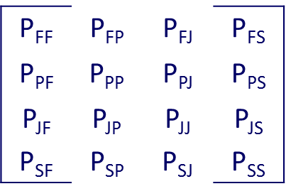
Enhancing the Model
We have so much data, we should be using it!
Incorporate 5 years of historical data
Build five Transition Probability Matrices for each set of historical Fall to Spring terms
Average them to create a master Transition Probability Matrix
Fall 2016 Spring 2017
Fall 2015 Spring 2016
Fall 2014 Spring 2015
Fall 2013 Spring 2014
Fall 2012 Spring 2013

Slide 11
Enhancing the Model
Detailed states to track granular flows of students
Concatenate multiple variables to create detailed states that are exhaustive and mutually exclusive
  Degree
  Enrollment Status
  Class
  Full-time vs Part-time
DEGREE
0 | Post Baccalaureate Certificate
3 | Bachelor's
4 | Master's
5 | Post Master's Certificate
8 | Unclassified
P | Doctoral Professional
R | Doctorate
ENROLL
1 | New Student
2 | New Transfer Student
3 | Continuing Student
4 | Returning Student
6 | Unclassified
CLASS
1 | Freshman
2 | Sophomore
3 | Junior
4 | Senior
6 | Unclassified Undergraduate
7 | Graduate
TIME
F | Full-time
P | Part-time
Example: 3_2_3_P is a new transferring junior seeking a Bachelor’s degree part-time

Slide 12
New Entries
There are new students entering and exiting the university every semester
Exits are already accounted for by using the Transition Probability Matrix
New entries must be modeled separately
  Use our semester pairings to identify how many new students entered each Spring
    Flag students who were not here in Fall, but were here in Spring
Our data shows that new entries are very consistent across semesters, so we can estimate future new entries using linear regression
3_2_3_P | New Transferring Junior seeking a Bachelor’s degree Part-time
Semester | Number of New Entries
Spring 2018 estimate | 141
Spring 2017 | 118
Spring 2016 | 109
Spring 2015 | 74
Spring 2014 | 61
Spring 2013 | 41

Slide 13
Enhanced Markov Chain Model
Number of students we have this semester in each state at time t
Probabilities of moving amongst each state, averaged across past 5 years
Predicted new entries into each state
Estimated number of students in each state next semester
x
+
=
P_{3_1_1_F} _{3_1_1_F} | P_{3_1_1_F} _{3_1_1_P} | P_{3_1_1_F} _{3_2_3_F} | …
P_{3_1_1_P} _{3_1_1_F} | P_{3_1_1_P} _{3_1_1_P} | P_{3_1_1_P} _{3_2_3_F} | …
P_{3_2_3_F} _{3_1_1_F} | P_{3_2_3_F} _{3_1_1_P} | P_{3_2_3_F} _{3_2_3_F} | …
… | … | … | …
3_1_1_F_{t} | 3_1_1_P_{t} | 3_2_3_F_{t} | …
x
+
3_1_1_F_{new} | 3_1_1_P_{new} | 3_2_3_F_{new} | …
=
3_1_1_F_{t+1} | 3_1_1_P_{t+1} | 3_2_3_F_{t+1} | …

Slide 14
Markov Chain Modeling in SAS
Efficiently process large data
  Combine multiple historical datasets
Dynamic model
  Enter term predicted, SAS does the rest
Concatenate multiple variables to create detailed flow states
  Very large Transition Probability Matrices
Easily conduct multiple kinds of analyses
  Regressions, crosstabulations, matrix algebra, etc.

Slide 15
SAS Methodology
Step 1
Read in the data – student level, most recent term and past 5 years
  Concatenate Degree, Enrollment Status, Class, and Full-time/Part-time
Step 2
Create five semester pairings of Springs > Falls (or Falls > Springs)
Step 3
Create five transition probability matrices for each semester pairing
  Compare semester pairings to see what percentage of students in each flow state retained, dropped out, or moved to another flow state
Step 4
Average across the five transition probability matrices to create an overall Transition Probability Matrix
Step 5
Pull in last semester’s enrollment values as our baseline population
Step 6
Use linear regression to model new entries
Step 7
Use PROC IML to forecast enrollment for next semester!

Slide 16
Dynamic SAS Programming
Macro
Variables
Macro
Programs
Minimizes
risk of user-error
Simple to update
Efficient

Slide 17
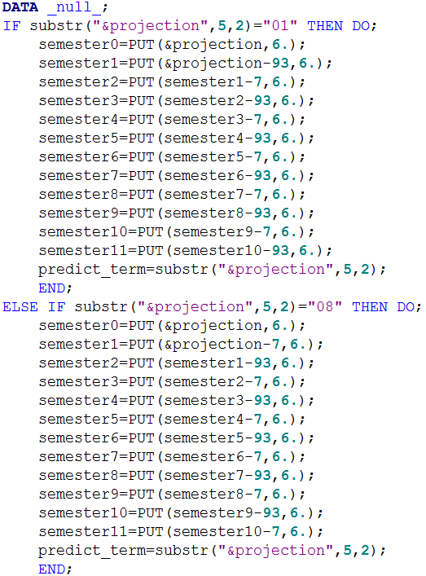

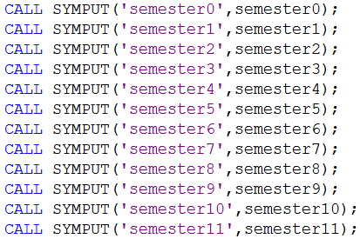
only element the user changes
SAS processes simple mathematics to create variables for past semesters.
Given a projection term of ‘201801’, code resolves:
semester0 = 201801
semester1 = 201708
semester2 = 201701
semester3 = 201608
semester4 = 201601
semester5 = 201508
semester6 = 201501
semester7 = 201408
semester8 = 201401
semester9 = 201308
semester10 = 201301
semester11 = 201208
The CALL SYMPUT routine creates macro variables for each semester that assign the calculated semester values

Slide 18
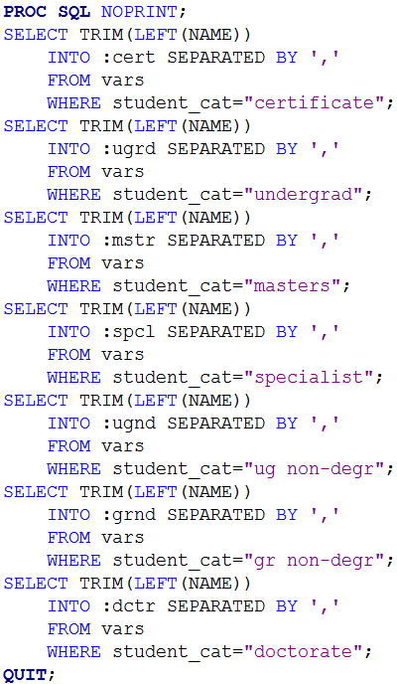
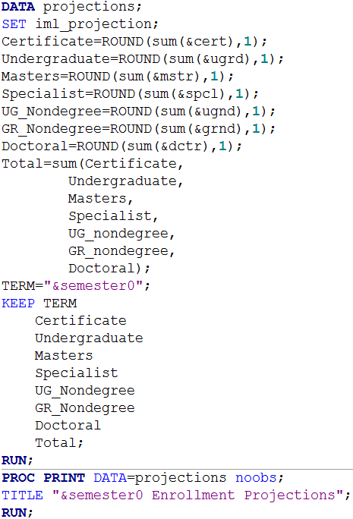
creating macro variables for each student category within a PROC SQL step
call the macro variables anywhere throughout the program

Slide 19
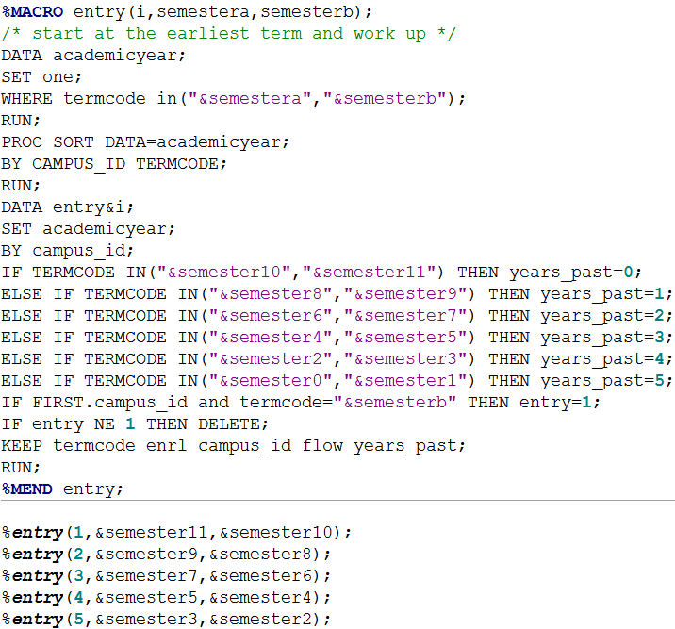
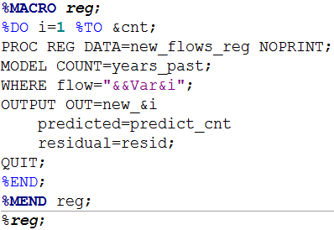
macro program that compares semester pairs
to identify new entries between first and second semester
macro program that loops through every distinct flow state and conducts a linear regression to predict new entries into each flow state
uses macro variables for each flow state
uses macro variables to determine semester pairs

Slide 20
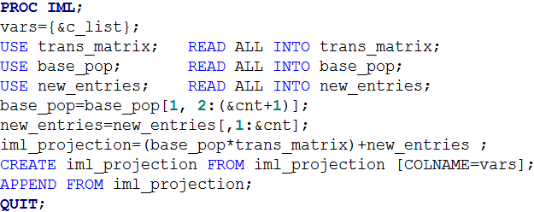
PROC IML in SAS
Number of students we have this semester in each state at time t
x
Probabilities of moving amongst each state, averaged across past 5 years
+
Predicted new entries into each state
=
Estimated number of students in each state next semester

Slide 21
Results
Semester | Undergraduate | Non-Degree Seeking Undergraduate | Certificate | Masters | Specialist | Doctoral | Non-Degree Seeking Graduate | Total Enrollment
Spring 2013 | 13,563 | 296 | 0 | 2,066 | 100 | 778 | 529 | 17,332
Spring 2014 | 13,294 | 298 | 155 | 1,915 | 97 | 735 | 377 | 16,871
Spring 2015 | 13,702 | 360 | 127 | 1,927 | 107 | 764 | 332 | 17,319
Spring 2016 | 14,265 | 404 | 206 | 1,924 | 44 | 794 | 240 | 17,877
Spring 2017 | 14,874 | 420 | 167 | 1,838 | 22 | 920 | 270 | 18,511
Projected Spring 2018 | 15,105 | 398 | 130 | 1,925 | 38 | 834 | 239 | 18,669
Actual Spring 2018 | 15,116 | 388 | 143 | 1,965 | 21 | 981 | 232 | 18,846

Slide 22
Results

Slide 23
Questions?
You can download this presentation at: https://ire.uncg.edu/research/SRB-AIR-2018
Contact info:
Samantha Bradley srbradle@uncg.edu
(336) 256-0399

Slide 24
Thank you
Please remember to submit your evaluation for this session.

